Slide 1
Object Oriented Computer Programming in C++
Course Code :: CS131303

Slide 2
Object-Oriented Programming (OOP) Vs Procedural Programming
Procedural programming is
About writing procedures or methods that perform operations on the data
object-oriented programming is
About creating objects that contain both data and methods

Slide 3
Object-Oriented Programming (OOP)
A computer programming model that
Organizes software design around data or objects rather than functions and logic
An object can be defined as a data field that has unique attributes and behaviour
Examples of an object can range from physical entities, such as a human being who is described by properties like name, address, etc. to small computer programs such as widgets
OOP focuses on
The objects that developers want to manipulate rather than the logic required to manipulate them
Well-suited for programs that are large, complex and actively maintained
This includes programs for manufacturing and design, as well as mobile applications

Slide 4
Advantages of Object-Oriented Programming over Procedural Programming
OOP is faster and easier to execute
OOP provides a clear structure for the programs
OOP helps to reduce the repetition of code and makes the code easier to maintain, modify and debug
OOP makes it possible to create full reusable applications with less code and shorter development time

Slide 5
Object-Oriented Programming
Some common examples of Object-Oriented Programming are:
C++
Java
C#
Python
JavaScript
R
Perl
Etc.

Slide 6
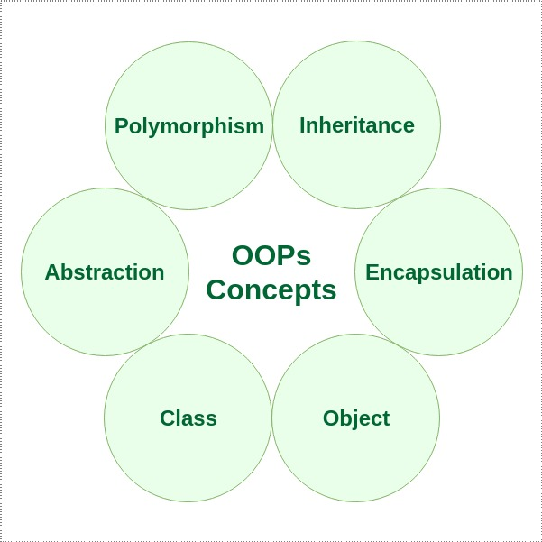
Features of Object-Oriented Programming
Some important features of Object-Oriented Programming
Class
Objects
Encapsulation
Abstraction
Polymorphism
Inheritance
Dynamic Binding
Message Passing

Slide 7
Classes and Objects
An object is
A basic unit in object-oriented programming
An instance of a class
Contains data and methods or functions that operate on that data
Take up space in memory
A class is
A blueprint to build a specific type of object
determines how an object will behave and what the object will contain
Does not take any space in the memory

Slide 8

Classes and Objects
Example

Slide 9
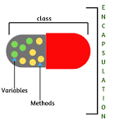
Encapsulation
Encapsulation is defined as
Wrapping up of data and information under a single unit
Binds the data and the functions that manipulates them together
Used frequently in the form of classes

Slide 10
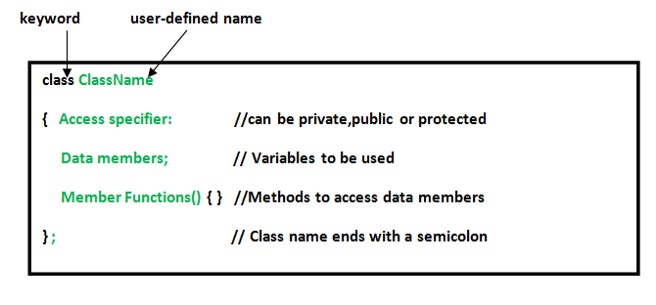
Implementing Classes and Objects in C++
Defining a class
Declaring Objects
When a class is defined, only the specification for the object is defined
No memory or storage is allocated
To use the data and access functions defined in the class, objects need to created
Syntax:
ClassName ObjectName;

Slide 11
Accessing data members and member functions
Accessing a member of a class depends solely on
The access control of that data member
The data members and member functions of class can be accessed
Using the dot(‘.’) operator with the object
For example, if the name of the object is obj, the member function with the name say, xyz() can be accessed as
obj.printName()
The public data members are also accessed in the same way
However, the private members are
Not allowed to be accessed directly by the object

Slide 12
Implementing Classes and Objects in C++
Example
#include<iostream>
using namespace std;
Class Test_1
{
private:
int x;
public:
void set(int a)
{
x =a;
}
int get()
{
return x;
}
};
int main
{
Test_1 t1;
t1.set(5);
cout << t1.get();
return 0;
}

Slide 13
using namespace std in C++
Consider a situation,
Suppose, there are two persons with the same name, John, in the same class
To differentiate them
Need to use some additional information along with their name, such as phone number, DOB etc
The same situation can arise in your C++ applications
For example,
A program has a function called xyz() and there is another library available which is also having same function xyz().
Now the compiler has no way of knowing which version of xyz() function is referred to within the code

Slide 14
using namespace std in C++
Namespaces in C++ are used
To organize too many classes so that it can be easy to handle the application
For accessing the class of a namespace
Need to use namespacename::classname
We can use using keyword
So that we don't have to use complete name all the time
In C++
Global namespace is the root namespace
The global::std will always refer to the namespace "std" of C++ Framework

Slide 15
Access Specifiers in C++
Access specifiers define
How the members (attributes and methods) of a class can be accessed
In C++, there are three access specifiers:
public
Members are accessible from outside the class
private
Members cannot be accessed (or viewed) from outside the class
protected
Members cannot be accessed from outside the class, however, they can be accessed in inherited classes

Slide 16
Access Specifiers in C++
Example
class Test_2
{
public: // Public access specifier int x; // Public attribute private: // Private access specifier int y; // Private attribute }; int main()
{ Test_2 myObj; myObj.x = 25; // Allowed (public) myObj.y = 50; // Not allowed (private) return 0;
}

Slide 17
Basic Input / Output in C++
C++ comes with libraries that provides
Many ways for performing input and output
In C++, input and output are performed in the form of
A sequence of bytes or more commonly known as streams
Input Stream
If the direction of flow of bytes is from the device(for example, Keyboard) to the main memory then this process is called input
Output Stream
If the direction of flow of bytes is opposite, i.e. from main memory to device( display screen ) then this process is called output

Slide 18
Basic Input / Output in C++
Header files available in C++ for Input/Output operations
iostream (input-output stream)
iostream stands for standard input-output stream
This header file contains definitions of objects like cin, cout, cerr, etc.
iomanip (input-output manipulators)
The methods declared in these files are used for manipulating streams
This file contains definitions of setw, setprecision, etc.
Fstream
This header file mainly describes the file stream
This header file is used to handle the data being read from a file as input or data being written into the file as output

Slide 19
Basic Input / Output in C++
In c++, there are two most basic methods of taking input and printing output which are
Standard input stream (cin)
Usually the input device in a computer is the keyboard
Used to read input from the standard input i.e., a keyboard The extraction operator(>>) is used along with the object cin for reading inputs
The extraction operator extracts the data from the object cin which is entered using the keyboard
Standard output stream (cout)
It is used to produce output on the standard output device which is usually the display screen
The data needed to be displayed on the screen
Is inserted in the standard output stream (cout) using the insertion operator(<<) included in the program

Slide 20
Basic Input / Output in C++
Example
#include <iostream>
using namespace std;
int main()
{
int x;
cout << "Enter a number\n";
cin >> x;
cout << "x = " << x;
}

Slide 21
Defining Member Functions in C++
There are two ways to define a member function:
Inside class definition
Outside class definition
To define a member function outside the class definition
The scope resolution :: operator is used along with class name and function name

Slide 22
Defining Member Functions in C++
Example
#include<iostream>
using namespace std;
class Test_3
{
private:
int x;
public:
void set(int a)
{
x =a;
}
get();
};
int Test_3 :: get()
{
return x;
}
int main()
{
test_3 t3;
t3.set(5);
cout << t3.get();
return 0;
}

Slide 23
Constructors
A class constructor is a special member function of a class
Executed whenever we create new objects of that class
Have exact same name as the class
Does not have any return type (not even void)
Can be very useful for setting initial values for certain member variables
Can be defined either inside the class definition or outside class definition using class name and scope resolution :: operator

Slide 24
Constructors
Example
class A
{
public:
int i;
A( ); // constructor declared
};
A :: A( ) // constructor definition
{
i = 1;
}

Slide 25
Types of Constructors in C++
Three types
Default Constructor
Doesn't take any argument
Parametrized Constructor
Have parameters
Copy Constructor
Special type of Constructors which takes an object as argument
Used to copy values of data members of one object into other object

Slide 26
Types of Constructors
Three types
Default Constructor
Doesn't take any argument
Parametrized Constructor
Have parameters
Copy Constructor
Special type of Constructors which takes an object as argument
Used to copy values of data members of one object into other object

Slide 27
Default Constructors
Example
class cube
{
public:
Int side;
cube( ); // constructor declared
};
cube :: cube( ) // constructor definition
{
side = 10;
}
int main()
{
cube c;
cout << c.side ;
return 0;
}
Output:
10

Slide 28
Default Constructors
Example
class cube
{
public:
int side;
};
int main()
{
cube c;
cout << c.side ;
return 0;
}
Output:
0 or any random value
If we do not define a constructor explicitly, the compiler will provide a default constructor implicitly

Slide 29
Parameterized Constructors
Using this Constructor
We can provide different values to data members of different objects by passing the appropriate values as argument
Example
class cube
{
public:
int side;
cube( int x)
{
side = x;
}
};
int main()
{
cube c1(10);
cube c2(20);
cout << c1.side ;
cout << c2.side ;
return 0;
}
Output:
10
20

Slide 30
Copy Constructors
Special type of Constructors
Which takes an object as argument
Is used to copy values of data members of one object to another object
Example
class copy_constructor
{
private:
int x;
public:
copy_constructor( int y)
{
x= y;
}
copy_constructor(const copy_constructor &c)
{
x = c.x ;
}
};
void display()
{
cout << x << endl;
}
int main()
{
copy_constructor c1(10);
copy_constructor c2 = c1;
c1.display() ;
c2.display() ;
return 0;
}
Output: 10 10

